Slide 1
AC Network Analysis - Phasor
Represent sinusoidal signals as complex numbers, and to eliminate the need for solving differential equations.
You need to review complex algebra
Find a reasonably complete treatment in Appendix A (available online), including solved examples and Check Your Understanding exercises.

Slide 2
AC Network Analysis - Phasor
It will be assumed that you are familiar with both the rectangular and the polar forms of complex number coordinates; with the conversion between these two forms; and
with the basic operations of addition, subtraction, multiplication, and division of complex numbers.

Slide 3
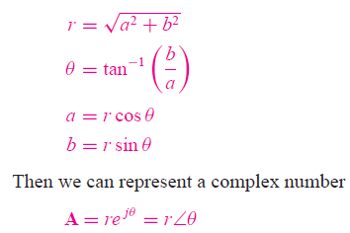
AC Network Analysis - Phasor
It will be assumed that you are familiar with both the rectangular and the polar forms of complex number coordinates; with the conversion between these two forms;

Slide 4
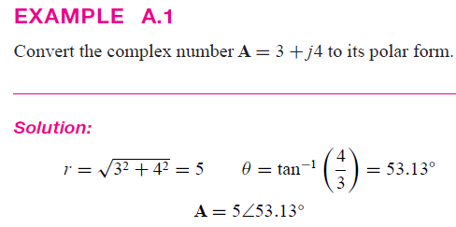
AC Network Analysis - Phasor
It will be assumed that you are familiar with both the rectangular and the polar forms of complex number coordinates; with the conversion between these two forms;

Slide 5
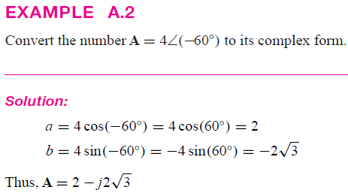
AC Network Analysis - Phasor
It will be assumed that you are familiar with both the rectangular and the polar forms of complex number coordinates; with the conversion between these two forms;

Slide 6

AC Network Analysis - Phasor
It will be assumed that you are familiar with both the rectangular and the polar forms of complex number coordinates; with the conversion between these two forms;

Slide 7
AC Network Analysis - Phasor
It will be assumed that you are familiar with both the rectangular and the polar forms of complex number coordinates; with the conversion between these two forms;

Slide 8
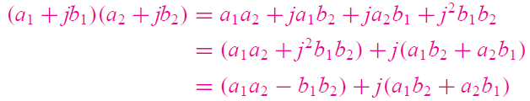
AC Network Analysis - Phasor
It will be assumed that you are familiar with both the rectangular and the polar forms of complex number coordinates; with the conversion between these two forms;

Slide 9

AC Network Analysis - Phasor
It will be assumed that you are familiar with both the rectangular and the polar forms of complex number coordinates; with the conversion between these two forms;

Slide 10

Phasor - Euler’s Identity
Swiss mathematician Leonhard Euler (the last name is pronounced “Oiler”), Euler’s identity forms the basis of phasor notation. Simply stated, the identity defines the complex exponential…
The as a point in the complex plane, which may be represented by real and imaginary components:

Slide 11
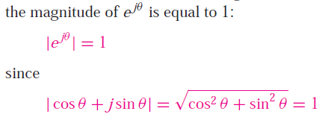
Phasor - Euler’s Identity
Figure 4.21 illustrates how the complex exponential may be visualized as a point (or vector, if referenced to the origin) in the complex plane. Note immediately that

Slide 12
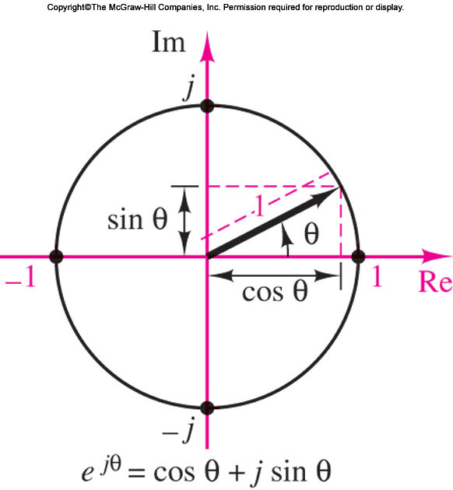
Phasor - Euler’s Identity
Figure 4.21 illustrates how the complex exponential may be visualized as a point (or vector, if referenced to the origin) in the complex plane…

Slide 13

Phasor - Euler’s Identity
Consider a vector of length A making an angle θ with the real axis. The following equation illustrates the relationship between the rectangular and polar forms:
Euler’s identity is simply a trigonometric relationship in the complex plane

Slide 14
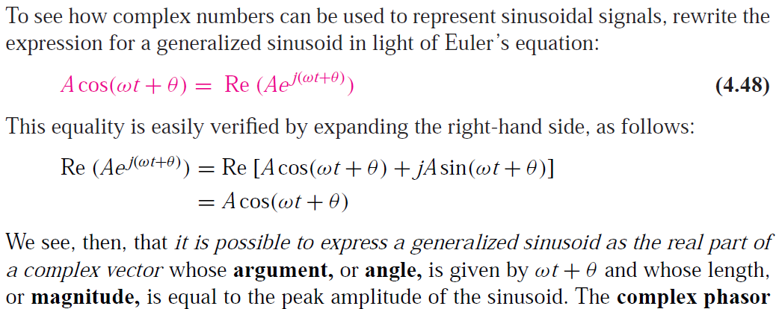
Phasor - Euler’s Identity

Slide 15
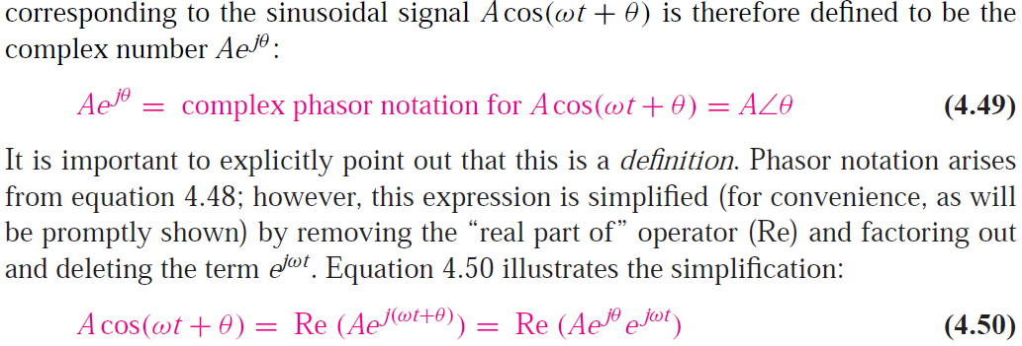
Phasor - Euler’s Identity
You will understand it by examples

Slide 16
Phasor - Euler’s Identity
Please always follow the “F O C U S O N M E T H O D O L O G Y” box as follows:

Slide 17
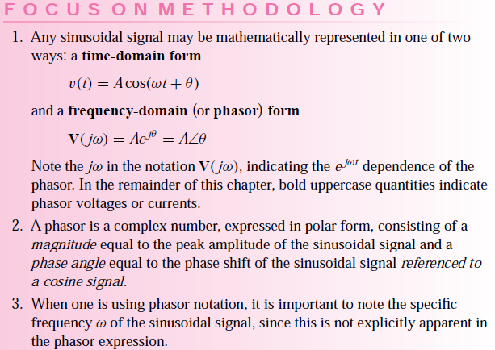
Phasor - Euler’s Identity
Please always follow the “F O C U S O N M E T H O D O L O G Y” box as follows:

Slide 18
Phasor - Euler’s Identity

Slide 19
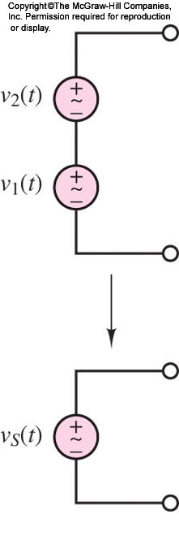
Phasor - Euler’s Identity - Examples
EXAMPLE 4.10 Addition of Two Sinusoidal Sources in Phasor
Compute the phasor voltage resulting from the series connection of two sinusoidal voltage
sources (Figure 4.22).

Slide 20
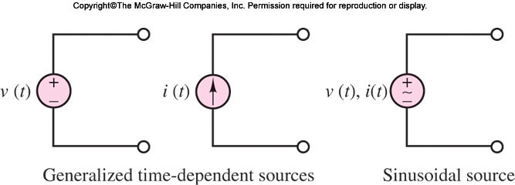
Time-dependent Signal Sources
Time-dependent signal sources: sources that generate time-varying voltages and currents and, in particular, sinusoidal sources.

Slide 21
Time-dependent Signal Sources
One of the most important classes of time-dependent signals is that of periodic signals.
These signals appear frequently in practical applications and are a useful approximation of many physical phenomena.

Slide 22
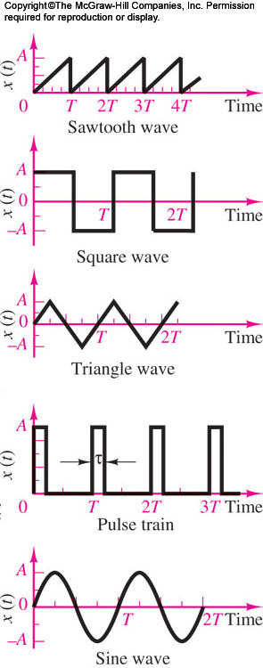
Time-dependent Sources
One of the most important classes of time-dependent signals is that of periodic signals.
These signals appear frequently in practical applications and are a useful approximation of many physical phenomena.

Slide 23

Time-dependent Signal Sources
A periodic signal x(t) is a signal that satisfies the equation.

Slide 24
Time-dependent Sources
Waveforms such as the sine, triangle, square, pulse, and sawtooth waves are provided in the form of voltages (or, less frequently, currents) by commercially available signal (or waveform) generators.

Slide 25
AC Network Analysis
Such instruments allow for selection of the waveform peak amplitude, and of its period.

Slide 26
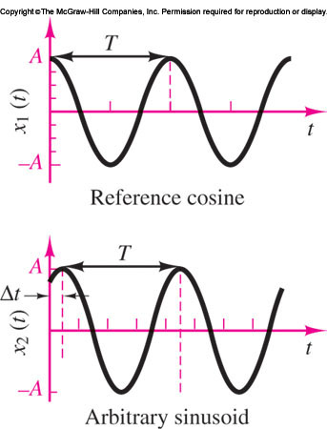

Time-dependent Signal Sources- Sinusoidal
Sinusoidal waveforms constitute by far the most important class of time-dependent signals. Figure depicts the relevant parameters of a sinusoidal waveform.
A generalized sinusoid is defined as

Slide 27



Time-dependent Signal Sources- Sinusoidal
A generalized sinusoid is
defined as

Slide 28
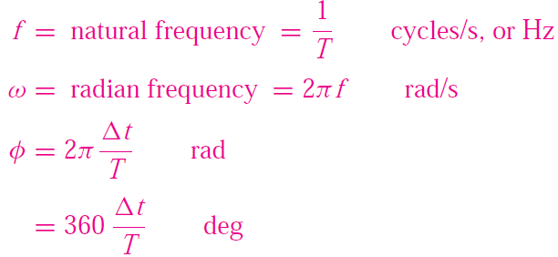
Time-dependent Signal Sources- Sinusoidal

Slide 29

Time-dependent Signal Sources- Sinusoidal
The phase shift φ permits the representation of an arbitrary sinusoidal signal.
one can represent a sine wave in terms of a cosine wave simply by introducing a phase shift of π/2 rad:

Slide 30
References
Giorgio Rizzoni, “Fundamentals of Electrical Engineering”, McGraw- Hill Education, 2009. ISBN. 978-0-07-338037-7
Peyton Z. Peebles (Author), Tayeb A. Giuma, Principles of Electrical Engineering (Mcgraw Hill Series in Electrical and Computer Engineering), Mcgraw-Hill College, 1991.
Allan R. Hambley, Electrical Engineering: Principles and Applications, Prentice Hall, ISBN-0132130068, 9780132130066, 2011.

Slide 31
Thank you !
Question?

